Slide 1
SUMMARY
Advertisement on packaged drinking water bottles (Rail Neer) decreases the price of packaged drinking water bottle and it would be able to afford packaged drinking water in journey for more and more people. Which also has the benefits like generation of more revenue for IRCTC, reduction in cost of packaged drinking water, lower selling price will increase sales, IRCTC would earn more profit and the clients would get readymade market. By taking everything into consideration this idea can be successfully implemented.

Slide 2
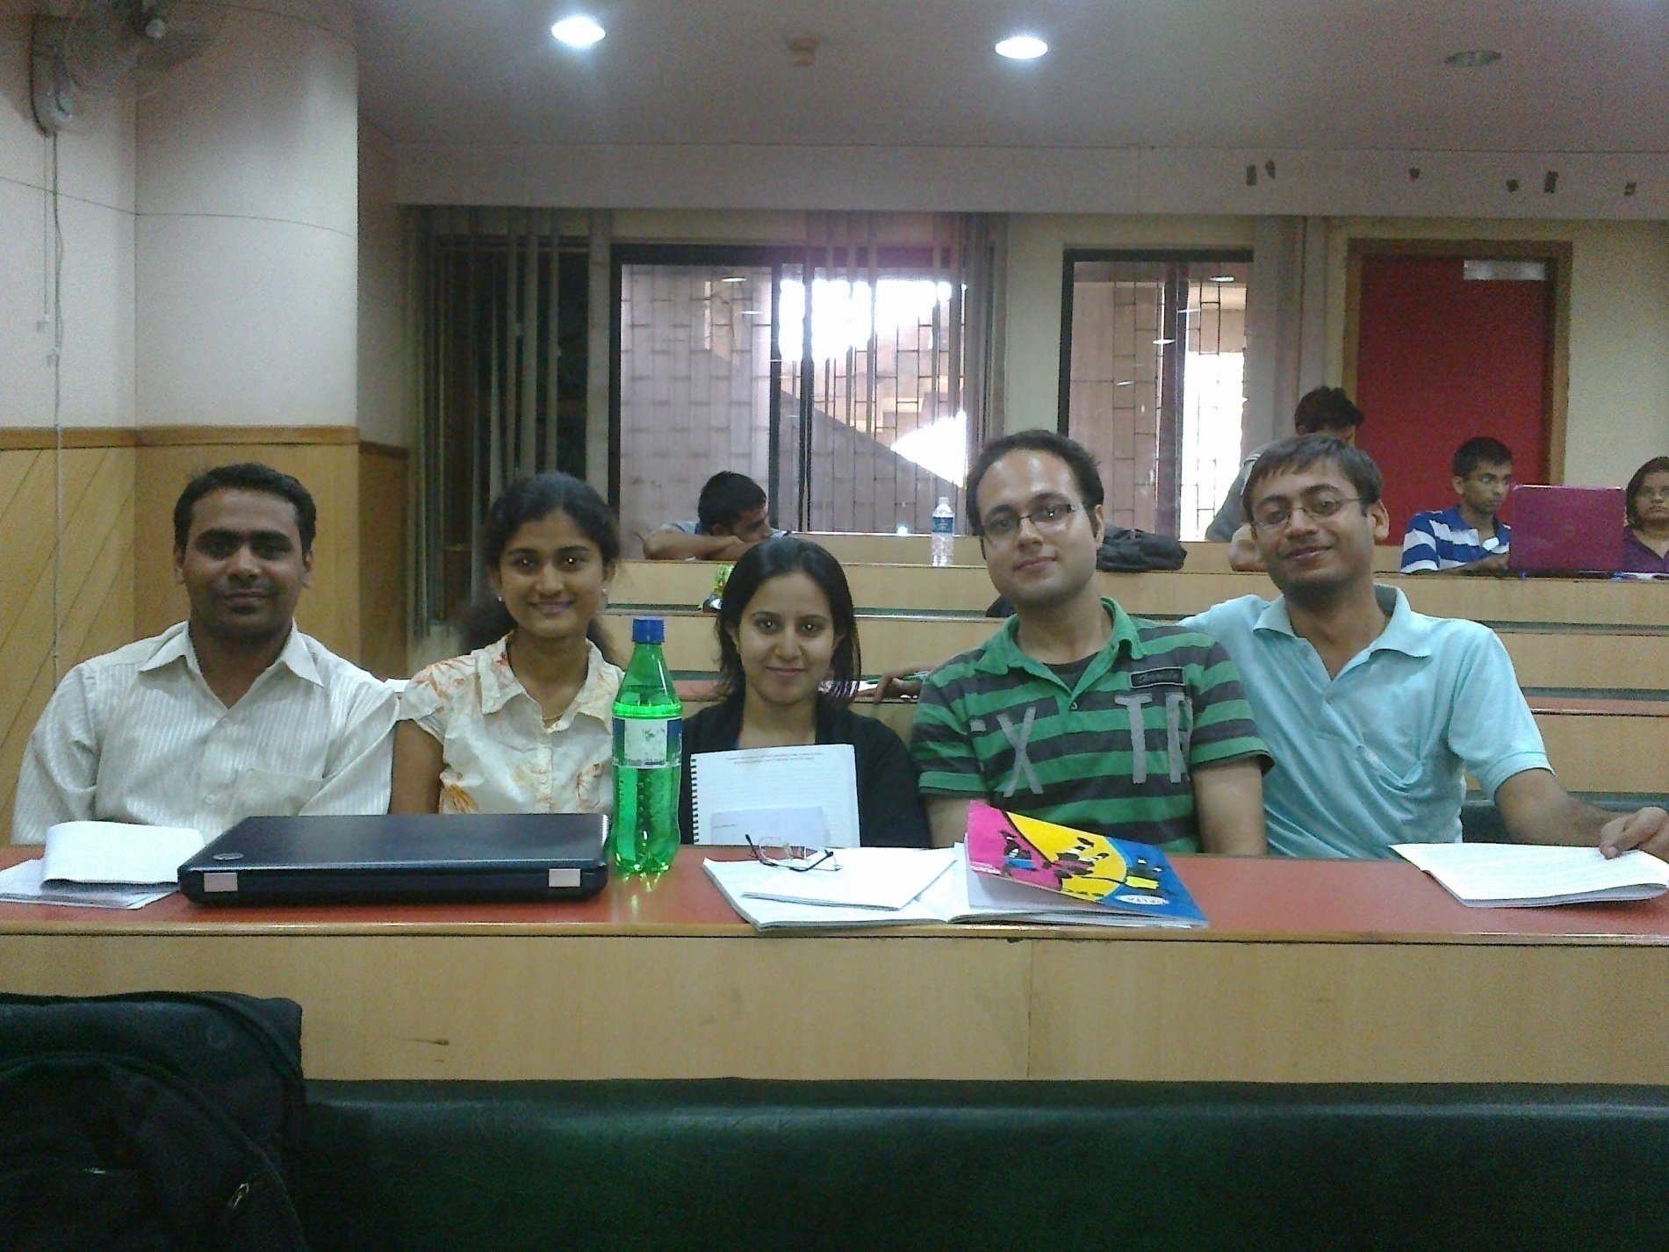
AQUAS
RAHUL
VAIBHAV
BLANDINA
NIKHIL
SAUMYA
GAGANESH HIMMAT

Slide 3
Top three ideas
Advertisement on packaged drinking water bottles (Rail Neer).
Pre earthquake detection using fishes.
Inclusion of gas timers in gas stoves.

Slide 4
Pain Area
High price of packaged drinking water
(IRCTC)

Slide 5
Reasons for choosing the topic
Impact
More affordable package drinking water in journey.
Market
Packaged water bottle industry is one of the fastest growing markets in India.
Competition
Our product will help the company to survive in the highly competitive market of packaged drinking water.

Slide 6
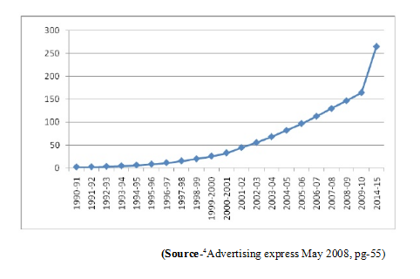
India is the fastest growing bottled water market !
X axis : year
Y axis : unit sales in million

Slide 7
Fish Bone Analysis
Commission
Bottle
quality
Dealers
Size (material quantity)
High price of packaged drinking water
Purification cost
Packaging cost
Financial constraint

Slide 8
Six Thinking Hats
White Hat | Green Hat | Red Hat | Black Hat | Yellow Hat
India is the 10th largest bottled water consumer in the world. Mandatory sale of rail neer in 180 railway stations. 3.80 Lac bottles(1 L) sell everyday. | Advertisement of private firms on packaged water bottles. | In my opinion this idea would definitely work. | Expensive packaging due to additional printing. | Generation of more revenue for IRCTC. reduction in cost of packaged drinking water. lower selling price will increase sales. private firms will be getting ready made markets.
Blue Hat Conclusion: by going with the facts and keeping everything into consideration, this idea can be successfully implemented.

Slide 9
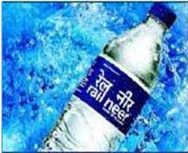
Business Plan
IRCTC has to advertise for tenders in newspapers and call for clients.
The highest bidder will get the tender to advertise his company on IRCTC water bottles.
With respect to the revenue generated the selling price of the water bottles would be decreased.
In this way more people would be able to afford packaged drinking water, IRCTC would earn more profit and the clients would get readymade market.

Slide 10
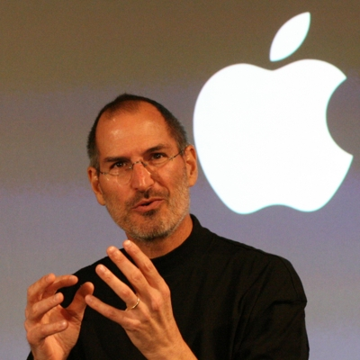
Real Leadership
Entrepreneurship-applying imagination to technology and business.
Best example- paradigm shift by Steve Jobs.
His techniques:
1. Focus
2. Simplify
3. Leapfrog
4. Products, not profit
5. Perfection is necessary
6.Bend Reality – impossible is nothing
7. Stay hungry , stay foolish and many more……
Now, APPLE Inc. is an enduring company !

Slide 11
References
http://dpe.nic.in/sites/upload_files/dpe/files/survey1011/survey01/volume2/300.pdf
http://pib.nic.in/archieve/lreleng/lyr2003/rmay2003/06052003/r0605200316.html

Slide 12
TEAM
SAUMYA DIXIT | GAUTAM BUDDHA UNIVERSITY, NOIDA
RAHUL GAIROLA | INDIAN INSTITUTE OF SCIENCE EDUCATION & RESEARCH, NADIA
BLANDINA JYOTHSNA FERNANDES | AIMIT, ST ALOYSIUS COLLEGE, MANGALORE
NIKHIL GULATI | FACULTY OF ENGINEERING, DAYALBGH EDUCTIONAL INSTITUTE, AGRA
GAGANESH
VAIBHAV
HIMMAT SINGH | ANSAL INSTITUTE OF TECHNOLOGY, GURGAON

Slide 13
THANK YOU

